Slide 1
MP-7 Safety January 31, 2011
Medical Monitor: Michael Mithoefer, MD

Slide 2
References
Can be found in….
MDMA Investigator’s Brochure, 6th edition September 2010
Literature Review annual updates
Lisa Jerome Ph.D
http://www.maps.org/mdma/protocol/litreview.html

Slide 3
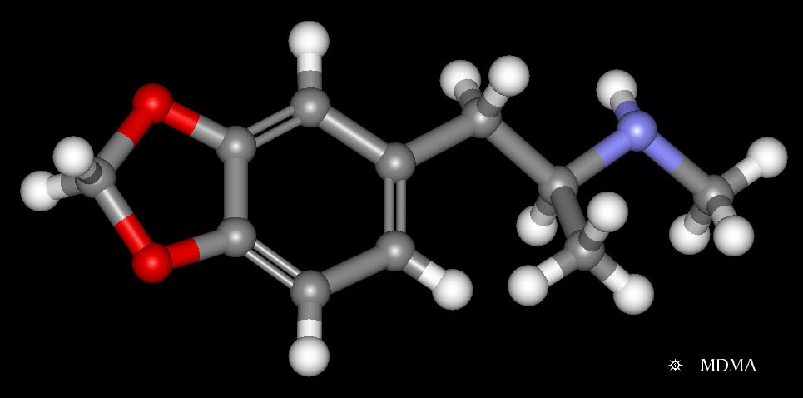
MDMA:
ring-substituted
phenylisopropylamine
derivative
patented in 1914 by Merck - now off-patent
“entactogens” - closeness to others, empathy, well being, and insightfulness, with little perceived loss of control
before MDMA becoming a controlled substance in 1985, a number of therapists used MDMA as an adjunct to psychotherapy in the United States and Europe
http://www.erowid.org/chemicals/mdma/mdma_chemistry.shtml

Slide 4
Complex pharmacological profile, dominated by:
Monoamine release and reuptake
Serotonin (5-HT)
greatest effects are on serotonin release
Norepinephrine (NE)
Dopamine (DA)
Some affinity for specific serotonin (5HT₂), norepinephrine, acetylcholine, histamine receptors

Slide 5
MDMA elevates plasma concentrations of a number of hormones
Oxytocin
Vasopressin
Cortisol
Prolactin
Dehydroepiandrosterone (DHEA)
Adrenocorticotropic hormone (ACTH)

Slide 6
MDMA activates the sympathetic nervous system
Transient increases in:
Heart rate
Systolic and diastolic blood pressure
Body temperature
Pupil diameter
Cardiovascular effects appear after 30 to 45 minutes, peak after 1 or 2 hours, and fade after 3 to 5 hours
No subjects in MDMA trials required any clinical interventions for:
Elevated blood pressure
Pulse
Temperature
All values returned to normal spontaneously.

Slide 8
Modest changes in immune functioning
24 - 48 hours after
Decline in CD4 cells, smaller CD4/CD8 ratio
Attenuated lymphocyte proliferation
Increase in natural killer (NK) cells
Decreased production of pro-inflammatory cytokines
Increased production of anti-inflammatory cytokines
Changes of similar magnitude and duration after ingestion of other psychoactive agents (e.g. alcohol, cocaine)

Slide 9
Toxicity
acute vs long term
recreational settings vs medical settings

Slide 10
Acute toxicity
Hyperthermia
Hepatotoxicity
Hyponatremia
can be fatal
Serious MDMA toxicity is rare
millions of users
ecstasy of unknown identity, potency, and purity
estimated MDMA doses that are several times higher than used MDMA therapy trials
the majority of ecstasy users visiting emergency departments do so because of anxiety

Slide 11
Serious acute toxicity has occurred
only in recreational settings
not in any clinical trials

Slide 12
MDMA Long-term Toxicity?
animal studies: long-term serotonergic brain changes after high dose MDMA regimens
some studies suggest clinically subtle neurocognitive changes in a subset of repeated users of illicit MDMA and other drugs
Phase I & Phase II data – MDMA in clinical research settings unlikely to cause persisting measurable reduction in serotonin function or lasting neurocognitive deficits
Performance not affected by participation in clinical MDMA trials
Tests of neurocognitive function – no change pre and post MDMA or placebo
Positron emission tomography (PET) data - no change in estimated serotonin transporter binding sites 4 weeks after a dose of MDMA similar to dose used in MAPS trials

Slide 13
Abuse liability - Recreational setting:
U.S. Schedule 1: includes drugs with high abuse potential and no known medical use
Self-administration studies in animals: abuse liability isn’t high
Abuse liability in monkeys: psychostimulants > MDMA
A small percentage of individuals develop ecstasy abuse or dependence
Taken together human and nonhuman studies
moderate abuse potential
higher than “classic hallucinogens” like psilocybin
lower than psychostimulants (e.g. cocaine, methamphetamine)

Slide 14
Abuse liability - therapeutic setting:
Swiss sample of largely drug-naïve participants after receiving MDMA in a controlled research - 0 / 74 expressed interest in taking MDMA as a recreational drug
In Phase 2 MDMA-assisted psychotherapy trials:
U.S. study: 1/20 reported trying MDMA after the research
Swiss study: 0/12 reported trying MDMA after the research
Notes:
trying to reproduce the therapeutic setting with a friend and said she would never do it again

Slide 15
Subjective effects
appear 30 – 60 minutes after ingestion
peak effects at 1 - 2 hours
last from 3 - 6 hours
Volunteers reported
“heightened senses”
slight changes in perception
brightness of the room or colors
sounds seeming closer or farther away
simple visual distortions
altered time perception
changed meaning or significance of perceptions

Slide 16
Volunteers maintained insight about their experience
Little indication of any strong alterations to the sense of self or control over the experience
Sense of wellbeing/bliss and/or anxiety and dysphoria
Sociability
Self-confidence
Extroversion
Processing painful experiences and emotions

Slide 17
“I don’t know why they call this ecstasy!”

Slide 18
Effects of MDMA
often increase in positive mood
increased access to emotionally intense material
increased interpersonal trust and compassion for the self and others – may help therapeutic alliance
may reduce anxiety
without depressing the sensorium
without inhibiting capacity to experience, reflect upon and communicate about intense emotions

Slide 19
Effects of MDMA
may increase anxiety
transiently during onset
later associated with emotional processing
unusual, innovative shifts in thinking and perception
new perspectives about past experiences or current reality

Slide 20
Magnifies whatever is there
affirming/joyful or difficult/painful

Slide 21
Common reactions to MDMA from literature
anxiety
difficulty concentrating
diarrhea
dizziness
drowsiness
dry mouth
fatigue
headache
impaired balance
Insomnia
increased irritability
jaw clenching
lack of appetite
low mood
muscle tension
nausea
nystagmus
parasthesias
perspiration
restlesness
rumination
sensitivity to cold
thirst
tight jaw
weakness

Slide 22
Additional effects
derealization/dissociation
visual disturbance
somatic sensations –various
regression

Slide 23
Common Reactions Day of Experimental Session

Slide 24
Common Reactions Day 1-7

Slide 25
Collection & Reporting of Adverse Events

Slide 26
Spontaneously Reported Reactions
Spontaneously reported reactions are compiled from the literature and cover expected adverse events on the day of and 7 days after MDMA administration.
A comprehensive list is included in the source and CRF for easy collection and reporting
Max intensity for the entire day is rated for severity (1=mild, 2=moderate, or 3=severe)
If the reaction persists after day 7, it becomes an AE and is tracked for full duration (including when it started Day 0-7).

Slide 27
Adverse Events
Any untoward medical occurrence in a subject administered an investigational product, at any dose, that does not necessarily have to have a causal relationship with this treatment.
An adverse event can be any unfavorable and unintended sign, symptom, or disease temporally associated with the use of a investigational product, whether or not considered related to the investigational product.
This definition includes intercurrent illnesses or injuries, and exacerbation of pre-existing conditions.

Slide 28
Collection of Adverse Events

Slide 29
Serious Adverse Events
Serious Adverse Event— An SAE is defined as any untoward medical occurrence that:
Results in death
Is life-threatening (i.e., the subject was, in the opinion of the CI, at immediate risk of death from the event as it occurred); it does not refer to an event which hypothetically might have caused death if it were more severe requires or prolongs inpatient hospitalization
Results in persistent or significant disability/incapacity
Results in a congenital anomaly/birth defect
Requires intervention to prevent permanent impairment or damage
Is an important and significant medical event that may not be immediately life- threatening or resulting in death or hospitalization, but based upon appropriate medical judgment, may jeopardize the patient/subject or may require intervention to prevent one of the other outcomes listed above
AEs which do not fall into these categories are defined as non-serious. A non-serious AE could be serious in nature and an SAE need not, by definition, be severe.

Slide 30
SAEs: Severity, (Un)expected
Severity—The degree of severity of the AE will be determined by the CI according to the following criteria.
Mild: No limitation in normal daily activity.
Moderate: Some limitation in normal daily activity.
Severe: Unable to perform normal daily activity.
Unexpected Adverse Event— Is an AE that is not listed in the current Investigators Brochure or an event that is by nature more specific, more severe than a listed event or a clinically important increase in the expected rate of occurrence.
Expected: An adverse event which is listed in the package insert, Investigator’s brochure, clinical protocol or current application known to occur in conjunction with the use of the suspect drug.

Slide 31
SAEs: Relationship
Relationship – A case is considered suspected to be related for worldwide regulatory purposes if it is assessed as possibly or probably related by either the CI or the MM.
1. Not Related- The AE is not related if exposure to the Investigational Product (IP) has not occurred, or the occurrence of the AE is not reasonably related in time, or the AE is considered unlikely to be related to use of the IP, i.e. there is no evidence or arguments to suggest a causal relationship, or the AE is more likely related to the subject’s pre-existing condition.
2. Possibly Related- The AE and the administration of the IP are considered reasonably related in time and the AE could be explained by causes other than exposure to the IP.
3. Probably Related- Exposure to the IP and AE are reasonably related in time and the IP is more likely than other causes to be responsible for the AE, or is the most likely cause of the AE.
4. Related - Exposure to the IP and AE are definitely related in time (e.g. proven by re-exposure to IP) and there is no other reasonable cause of the AE.

Slide 32
Suspected Unexpected Serious Adverse Reaction (SUSAR)
Suspected Unexpected Serious Adverse Reactions (SUSAR)—
An unexpected AE that is not listed in the Investigators Brochure.
A SUSAR is an SAE that is thought to be related, serious, unexpected
Reportable event to regulatory agencies.
The FDA must be notified within 15 calendar days of the sponsor’s initial receipt of the information for any reactions that are both serious and unexpected.
If the SAE is life-threatening or a death, the reporting period is decreased to 7 calendar days.
The FDA form 3500A noted as IND Safety Report or a CIOMS Form may be used to provide information to the appropriate agencies.
Narratives of the event and any similar events should be provided with the report.
Local regulations for expedited reportable AEs should be followed.
IRBs and CIs should be notified promptly in accordance with local regulations.
CIs should notify their respective IRBs according to IRB-specific timelines promptly after communication with the sponsor

Slide 33
The CRA will receive the fax form and:
Ensure that the report is processed
Contains the minimum required information:
subject number
name of the investigational product
name of the person reporting the event
description of the event
outcome that indicates that it is serious
CI’s assessment of relationship
Follows up any questions from the MM or designee
Ensures all follow up forms are received
ensures the sponsor section is completed
Files and tracks the SAEs
Reporting SAEs :
The CI determines an adverse event is serious.
The Site completes the SAE Form
Notifies MAPS and the MM, CRO and JFDA within 24 hours
Provides all required information available to date
All SAEs have to be reported within 24 hours, related or not
The site provides follow-up information, as it becomes available.
The MM or designee:
Reviews the SAE report form
Provides independent assessment of relationship
Comments on the event and expectedness as needed
Communicates as needed with the CI and CRA to ensure the assessment is complete
Signs the SAE report form
Works with the CI and CRA to determine reporting requirements

Slide 34
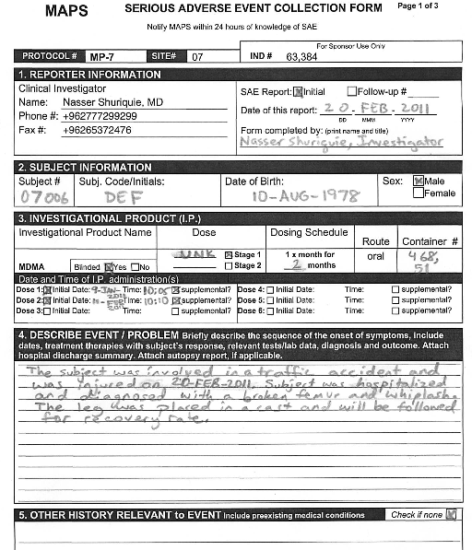
EXAMPLE SAE Form

Slide 35
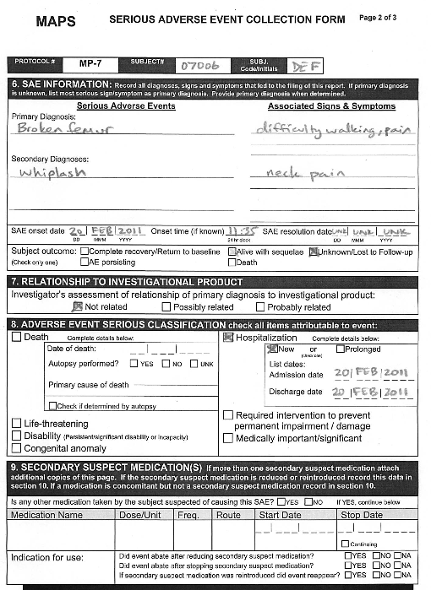
EXAMPLE SAE Form

Slide 36
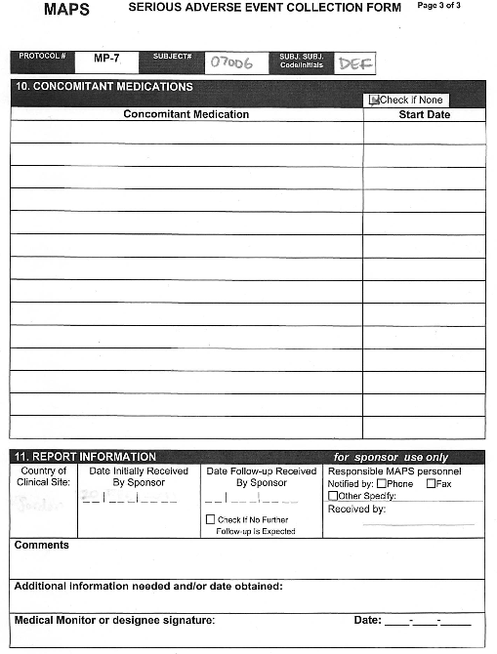
EXAMPLE SAE Form

Slide 37
Have Questions?
Email or Call:
CRO: Doaa Al-Faqih, Kamila Novak
Sponsor: Berra Yazar-Klosinski,
Michael Mithoefer – medical monitor

